Slide 1



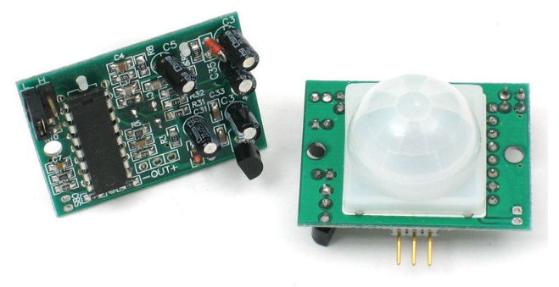

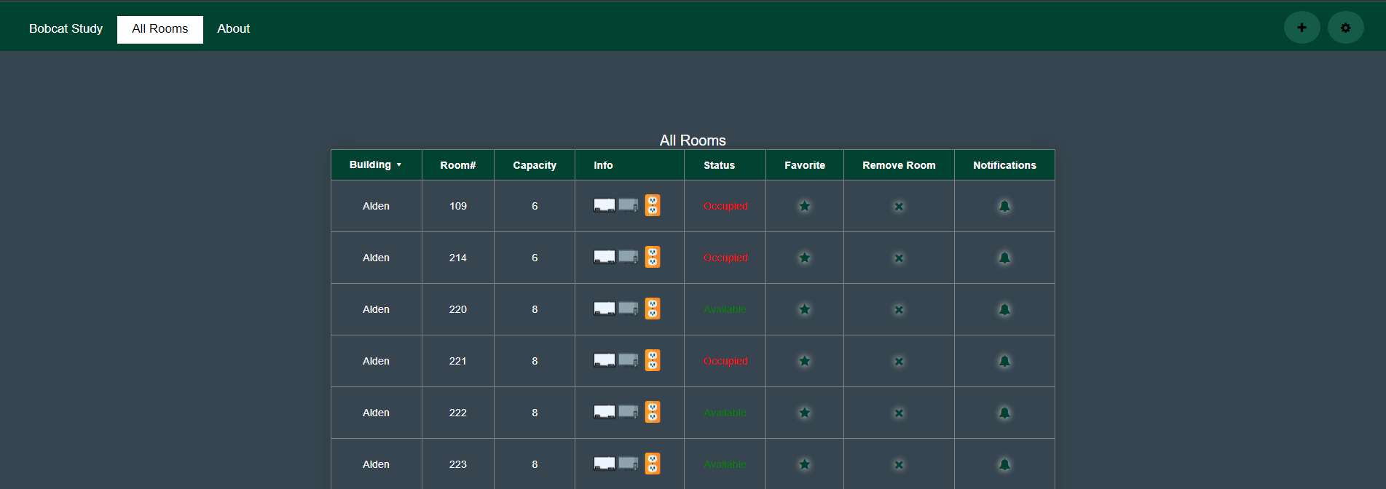
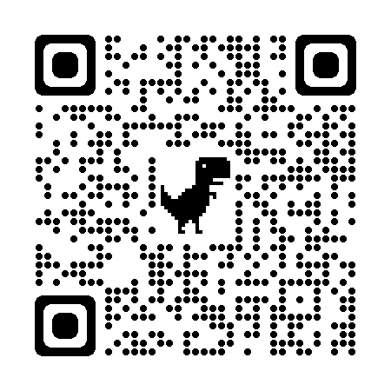
Alex Neargarder
Fadi Alrabadi
Zelin Zhang
Study Room Availability
Noah Glazier
Client: Nasseef Abukamail
Russ College of Engineering and Technology – Computer Science
Introduction
What if students had a way to see when their schools available study rooms were occupied or not before they step foot outside their door?
With Bobcat Study, we can implement sensors within each study room on campus and have it let the users know whether their favorite study room is empty or currently being used by other students.
Conclusion
In conclusion, we believe that our product could be used multiple times daily by students who live on campus and need a nice and quiet place to focus on their schoolwork and studying.
The objective of this project was to make a low cost, low maintenance application that students can use to know what rooms are available before they step foot outside their dorm rooms. I believe that we met those requirements. We made it based off the input and feedback of our peers and client and optimized the application to meet their standards.
The plan for this project continues to be the same but we plan to introduce new features later down the line to further accommodate students and faculty and give them a more complete app.
Design
Our user interface was designed to be simple, easy to use and minimalistic. We designed our product with the idea of keeping things simple and supplying the user with as much information possible at the press of a few buttons. We implemented themes for our users, such as light/dark mode, which they can select in their account settings page.
We implemented services such as Google Sign-In to accommodate the user and make it easier to sign in and ensure user privacy.
Technologies Used
Data Storage was done through the Firebase Firestore database.
Programming was done in ReactJS, we wrote mostly in JavaScript and wrote python scripts for our motion sensors and raspberry pi.
We used Apache to host our website and Cloudflare to create a more secure and private connection.
Finally, we used PIR sensors, or Passive Infrared sensors to detect motion in each room, which gets sent back to the database and changes the room status from “Available” to “Occupied”.
Future works
Plans for the future of this project includes:
Implementation of a notifications feature
Improve overall UI/UX of the project
Bug fixes
Add more room status options such as (Closed, unavailable, etc.)
Scan the QR code below to visit our website
References and Acknowledgements
All logos and photos have been taken from their respective websites,
Firebase is a mobile and web application development platform with database functionalities and cloud storage and authentication capabilities.
ReactJS is free and open-source front-end JavaScript library for building user interfaces based on UI components
Web and mobile product was produced by the team “Programming Paladins”, team members listed above.
PIR Sensors used in this project are made by Semedu.

